Slide 1



LOG IN
Email
example@gmail.com
Password
password123
Forgot Password?
Log In
ADS
CUSTOMER SERVICE
Cancellation Policy
Delivery
Order Verification
Payment FAQs
Privacy Policy
Terms and Conditions
Warranty
COMPANY
Careers
Contact Us
FAQs
News and Articles
Our Company
Reviews
Store Locations
LINKS
Gadget Spot Corporate
Gadget Spot Community
Lazada Official Store
Shopee Official Store
©2026 Gadget SPOT. ALL RIGHTS RESERVED

Slide 2



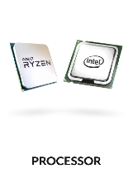
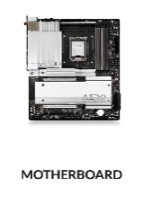
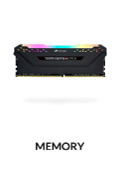
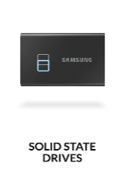
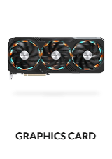
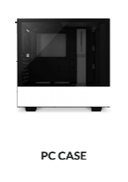
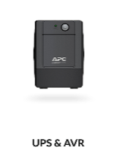
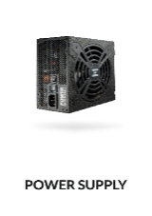
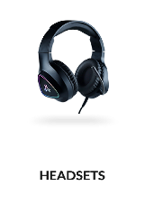
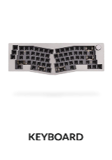
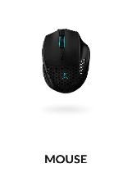
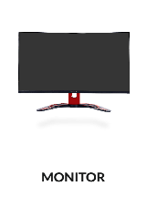
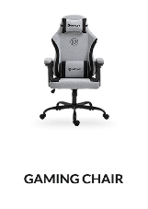
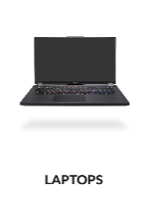
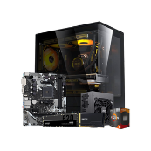
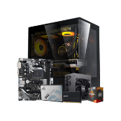
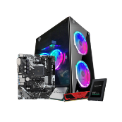
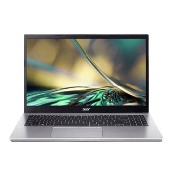
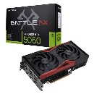
Search
CATEGORIES
FEATURED PRODUCTS
SAVE ₱1,085.00
SAVE ₱1,385.00
SAVE ₱2,000.00
SAVE ₱2,000.00
SAVE ₱2,665.00
Performance Desktop PC | 5700G APU | 16GB RAM | 512GB SSD
Starter Gaming Desktop PC | 5600G APU | 16GB RAM | 256GB SSD
AMD Ryzen3 3200G Gaming PC Bundle – 8GB RAM 256GB SSD
Acer Aspire 3 Slim 15.6” Intel Core i5 – 1235U/8GB/256GB SSD/Win11
Colorful GeForce RTX 5060 Battle AX DUO 8GB GDDR7 Graphics Card
₱22,995.00
₱18,995.00
₱18,995.00
₱26,995.00
₱18,595.00
BUY NOW
BUY NOW
BUY NOW
BUY NOW
BUY NOW
WHAT CUSTOMERS SAY ABOUT US
John Doe
Fast Delivery and legit Product. Gadget Spot Numbawan!!!
John Doe
Fast Delivery and legit Product. Gadget Spot Numbawan!!!
John Doe
Fast Delivery and legit Product. Gadget Spot Numbawan!!!
John Doe
Fast Delivery and legit Product. Gadget Spot Numbawan!!!
John Doe
Fast Delivery and legit Product. Gadget Spot Numbawan!!!
John Doe
Fast Delivery and legit Product. Gadget Spot Numbawan!!!
CUSTOMER SERVICE
Cancellation Policy
Delivery
Order Verification
Payment FAQs
Privacy Policy
Terms and Conditions
Warranty
COMPANY
Careers
Contact Us
FAQs
News and Articles
Our Company
Reviews
Store Locations
LINKS
Gadget Spot Corporate
Gadget Spot Community
Lazada Official Store
Shopee Official Store
©2026 Gadget SPOT. ALL RIGHTS RESERVED

Slide 3
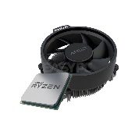
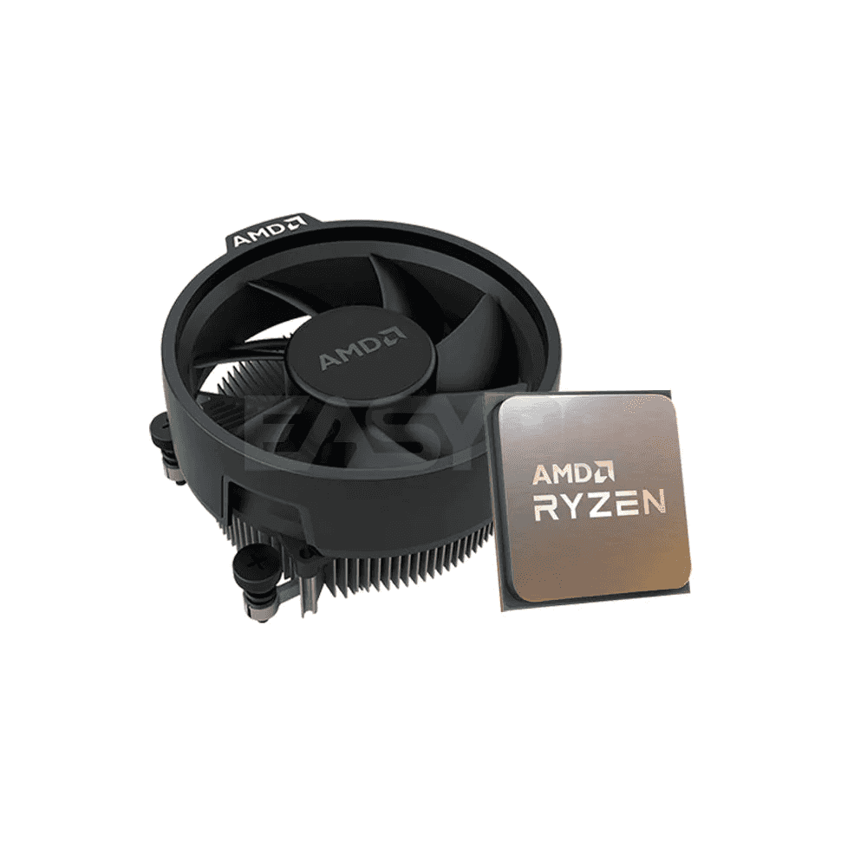
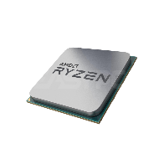
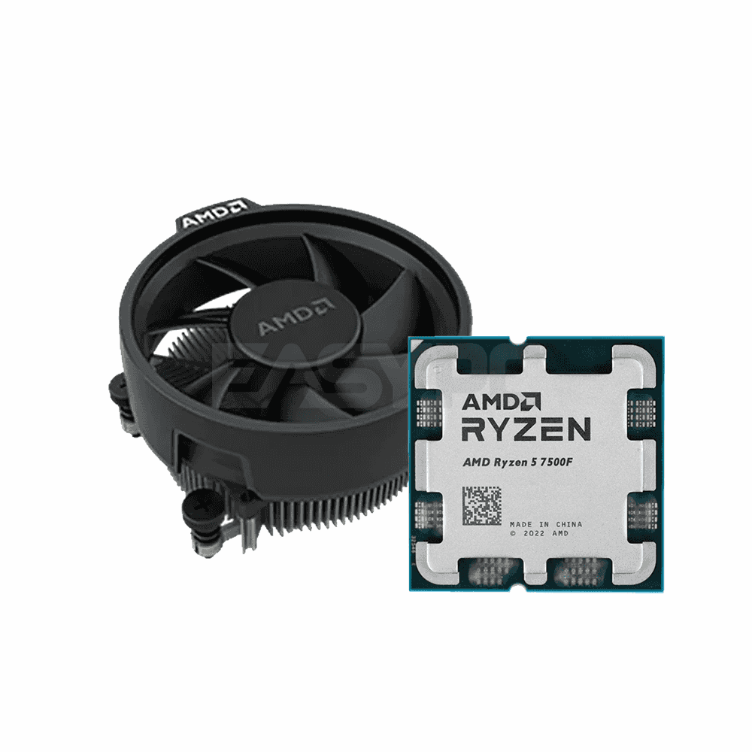
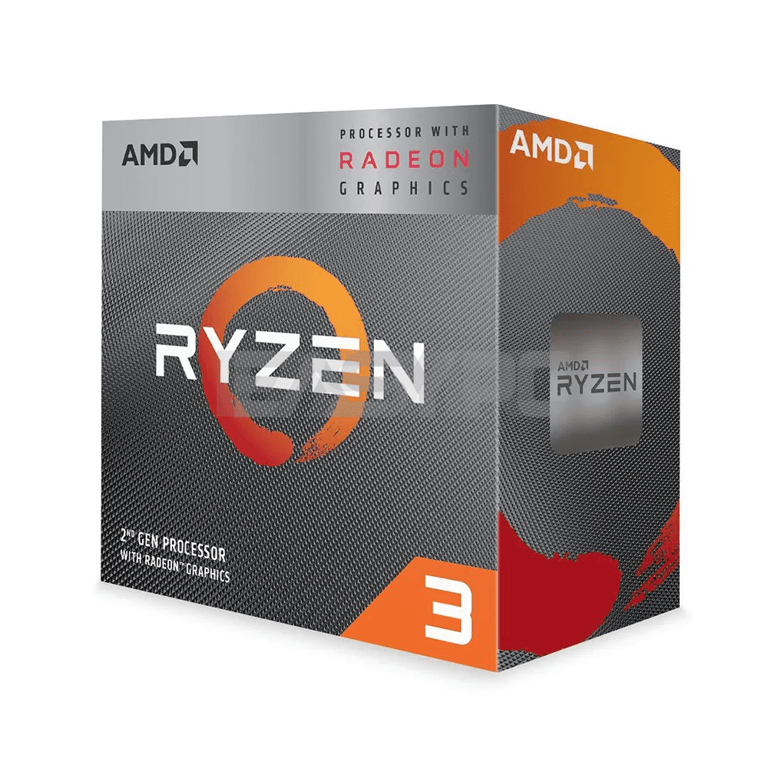
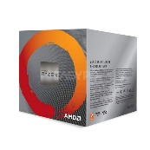
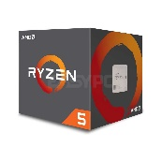
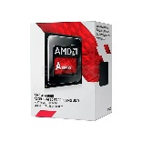

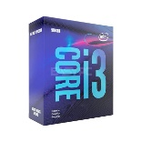

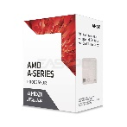

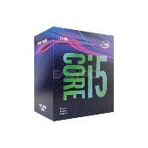
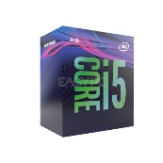
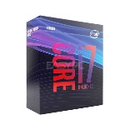
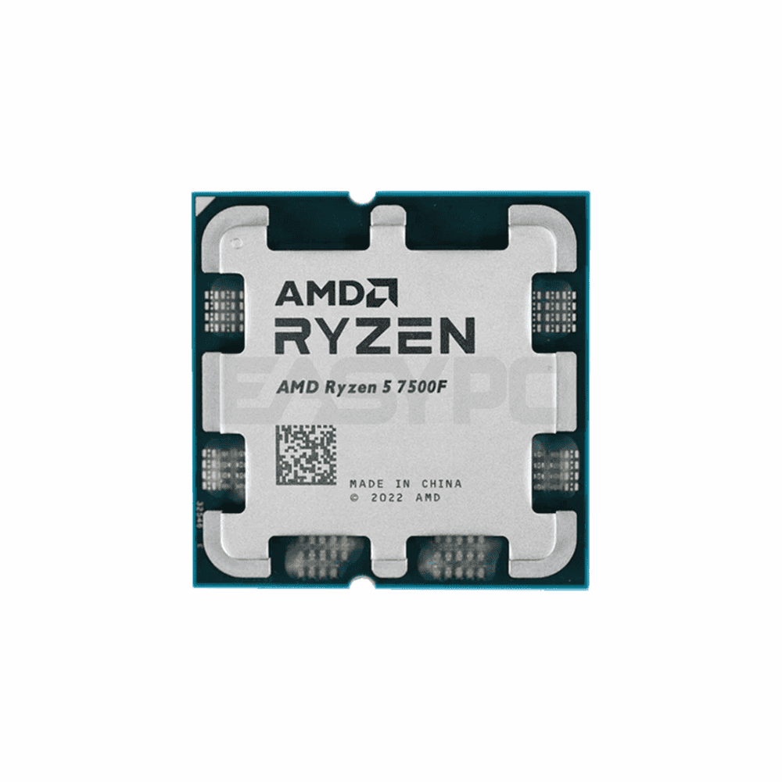
Search
PRODUCTS > PROCESSOR
SAVE ₱1,085.00
SAVE ₱1,385.00
SAVE ₱2,000.00
SAVE ₱2,000.00
SAVE ₱2,665.00
Performance Desktop PC | 5700G APU | 16GB RAM | 512GB SSD
Starter Gaming Desktop PC | 5600G APU | 16GB RAM | 256GB SSD
AMD Ryzen3 3200G Gaming PC Bundle – 8GB RAM 256GB SSD
Acer Aspire 3 Slim 15.6” Intel Core i5 – 1235U/8GB/256GB SSD/Win11
Colorful GeForce RTX 5060 Battle AX DUO 8GB GDDR7 Graphics Card
₱22,995.00
₱18,995.00
₱18,995.00
₱26,995.00
₱18,595.00
BUY NOW
BUY NOW
BUY NOW
BUY NOW
BUY NOW
SAVE ₱1,085.00
SAVE ₱1,385.00
SAVE ₱2,000.00
SAVE ₱2,000.00
SAVE ₱2,665.00
Performance Desktop PC | 5700G APU | 16GB RAM | 512GB SSD
Starter Gaming Desktop PC | 5600G APU | 16GB RAM | 256GB SSD
AMD Ryzen3 3200G Gaming PC Bundle – 8GB RAM 256GB SSD
Acer Aspire 3 Slim 15.6” Intel Core i5 – 1235U/8GB/256GB SSD/Win11
Colorful GeForce RTX 5060 Battle AX DUO 8GB GDDR7 Graphics Card
₱22,995.00
₱18,995.00
₱18,995.00
₱26,995.00
₱18,595.00
BUY NOW
BUY NOW
BUY NOW
BUY NOW
BUY NOW
SAVE ₱1,085.00
SAVE ₱1,385.00
SAVE ₱2,000.00
SAVE ₱2,000.00
SAVE ₱2,665.00
Performance Desktop PC | 5700G APU | 16GB RAM | 512GB SSD
Starter Gaming Desktop PC | 5600G APU | 16GB RAM | 256GB SSD
AMD Ryzen3 3200G Gaming PC Bundle – 8GB RAM 256GB SSD
Acer Aspire 3 Slim 15.6” Intel Core i5 – 1235U/8GB/256GB SSD/Win11
Colorful GeForce RTX 5060 Battle AX DUO 8GB GDDR7 Graphics Card
₱22,995.00
₱18,995.00
₱18,995.00
₱26,995.00
₱18,595.00
BUY NOW
BUY NOW
BUY NOW
BUY NOW
BUY NOW
SAVE ₱1,085.00
SAVE ₱1,385.00
SAVE ₱2,000.00
SAVE ₱2,000.00
SAVE ₱2,665.00
Performance Desktop PC | 5700G APU | 16GB RAM | 512GB SSD
Starter Gaming Desktop PC | 5600G APU | 16GB RAM | 256GB SSD
AMD Ryzen3 3200G Gaming PC Bundle – 8GB RAM 256GB SSD
Acer Aspire 3 Slim 15.6” Intel Core i5 – 1235U/8GB/256GB SSD/Win11
Colorful GeForce RTX 5060 Battle AX DUO 8GB GDDR7 Graphics Card
₱22,995.00
₱18,995.00
₱18,995.00
₱26,995.00
₱18,595.00
BUY NOW
BUY NOW
BUY NOW
BUY NOW
BUY NOW
CUSTOMER SERVICE
Cancellation Policy
Delivery
Order Verification
Payment FAQs
Privacy Policy
Terms and Conditions
Warranty
COMPANY
Careers
Contact Us
FAQs
News and Articles
Our Company
Reviews
Store Locations
LINKS
Gadget Spot Corporate
Gadget Spot Community
Lazada Official Store
Shopee Official Store
©2026 Gadget SPOT. ALL RIGHTS RESERVED

Slide 4
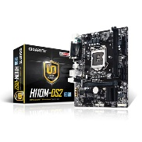
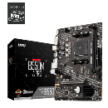
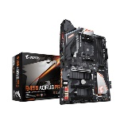
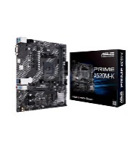
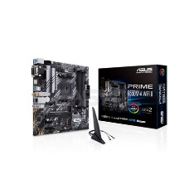
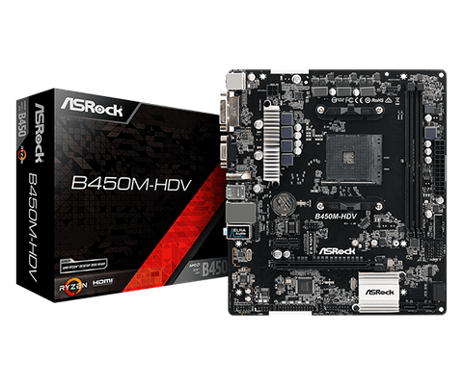
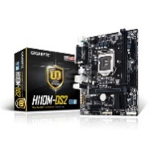
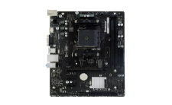
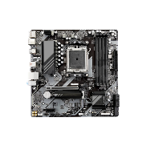
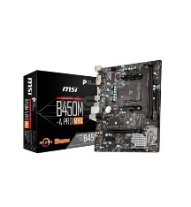
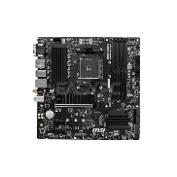
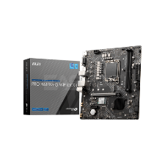
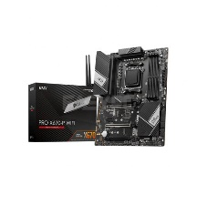
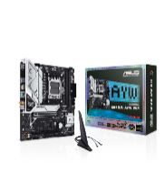
Search
PRODUCTS > MOTHERBOARD
SAVE ₱1,085.00
SAVE ₱1,385.00
SAVE ₱2,000.00
SAVE ₱2,000.00
SAVE ₱2,665.00
Performance Desktop PC | 5700G APU | 16GB RAM | 512GB SSD
Starter Gaming Desktop PC | 5600G APU | 16GB RAM | 256GB SSD
AMD Ryzen3 3200G Gaming PC Bundle – 8GB RAM 256GB SSD
Acer Aspire 3 Slim 15.6” Intel Core i5 – 1235U/8GB/256GB SSD/Win11
Colorful GeForce RTX 5060 Battle AX DUO 8GB GDDR7 Graphics Card
₱22,995.00
₱18,995.00
₱18,995.00
₱26,995.00
₱18,595.00
BUY NOW
BUY NOW
BUY NOW
BUY NOW
BUY NOW
SAVE ₱1,085.00
SAVE ₱1,385.00
SAVE ₱2,000.00
SAVE ₱2,000.00
SAVE ₱2,665.00
Performance Desktop PC | 5700G APU | 16GB RAM | 512GB SSD
Starter Gaming Desktop PC | 5600G APU | 16GB RAM | 256GB SSD
AMD Ryzen3 3200G Gaming PC Bundle – 8GB RAM 256GB SSD
Acer Aspire 3 Slim 15.6” Intel Core i5 – 1235U/8GB/256GB SSD/Win11
Colorful GeForce RTX 5060 Battle AX DUO 8GB GDDR7 Graphics Card
₱22,995.00
₱18,995.00
₱18,995.00
₱26,995.00
₱18,595.00
BUY NOW
BUY NOW
BUY NOW
BUY NOW
BUY NOW
SAVE ₱1,085.00
SAVE ₱1,385.00
SAVE ₱2,000.00
SAVE ₱2,000.00
Performance Desktop PC | 5700G APU | 16GB RAM | 512GB SSD
Starter Gaming Desktop PC | 5600G APU | 16GB RAM | 256GB SSD
AMD Ryzen3 3200G Gaming PC Bundle – 8GB RAM 256GB SSD
Acer Aspire 3 Slim 15.6” Intel Core i5 – 1235U/8GB/256GB SSD/Win11
₱22,995.00
₱18,995.00
₱18,995.00
₱26,995.00
BUY NOW
BUY NOW
BUY NOW
BUY NOW
CUSTOMER SERVICE
Cancellation Policy
Delivery
Order Verification
Payment FAQs
Privacy Policy
Terms and Conditions
Warranty
COMPANY
Careers
Contact Us
FAQs
News and Articles
Our Company
Reviews
Store Locations
LINKS
Gadget Spot Corporate
Gadget Spot Community
Lazada Official Store
Shopee Official Store
©2026 Gadget SPOT. ALL RIGHTS RESERVED

Slide 5
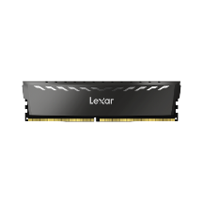
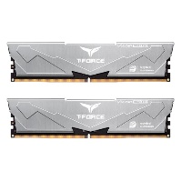
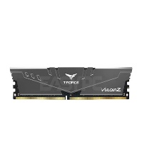









Search
PRODUCTS > MEMORY
SAVE ₱1,085.00
SAVE ₱1,385.00
SAVE ₱2,000.00
SAVE ₱2,000.00
SAVE ₱2,665.00
Performance Desktop PC | 5700G APU | 16GB RAM | 512GB SSD
Starter Gaming Desktop PC | 5600G APU | 16GB RAM | 256GB SSD
AMD Ryzen3 3200G Gaming PC Bundle – 8GB RAM 256GB SSD
Acer Aspire 3 Slim 15.6” Intel Core i5 – 1235U/8GB/256GB SSD/Win11
Colorful GeForce RTX 5060 Battle AX DUO 8GB GDDR7 Graphics Card
₱22,995.00
₱18,995.00
₱18,995.00
₱26,995.00
₱18,595.00
BUY NOW
BUY NOW
BUY NOW
BUY NOW
BUY NOW
SAVE ₱1,085.00
SAVE ₱1,385.00
SAVE ₱2,000.00
SAVE ₱2,000.00
SAVE ₱2,665.00
Performance Desktop PC | 5700G APU | 16GB RAM | 512GB SSD
Starter Gaming Desktop PC | 5600G APU | 16GB RAM | 256GB SSD
AMD Ryzen3 3200G Gaming PC Bundle – 8GB RAM 256GB SSD
Acer Aspire 3 Slim 15.6” Intel Core i5 – 1235U/8GB/256GB SSD/Win11
Colorful GeForce RTX 5060 Battle AX DUO 8GB GDDR7 Graphics Card
₱22,995.00
₱18,995.00
₱18,995.00
₱26,995.00
₱18,595.00
BUY NOW
BUY NOW
BUY NOW
BUY NOW
BUY NOW
SAVE ₱1,085.00
SAVE ₱1,385.00
Performance Desktop PC | 5700G APU | 16GB RAM | 512GB SSD
Starter Gaming Desktop PC | 5600G APU | 16GB RAM | 256GB SSD
₱22,995.00
₱18,995.00
BUY NOW
BUY NOW
CUSTOMER SERVICE
Cancellation Policy
Delivery
Order Verification
Payment FAQs
Privacy Policy
Terms and Conditions
Warranty
COMPANY
Careers
Contact Us
FAQs
News and Articles
Our Company
Reviews
Store Locations
LINKS
Gadget Spot Corporate
Gadget Spot Community
Lazada Official Store
Shopee Official Store
©2026 Gadget SPOT. ALL RIGHTS RESERVED

Slide 6



















Search
PRODUCTS > SOLID STATE DRIVES
SAVE ₱1,085.00
SAVE ₱1,385.00
SAVE ₱2,000.00
SAVE ₱2,000.00
SAVE ₱2,665.00
Performance Desktop PC | 5700G APU | 16GB RAM | 512GB SSD
Starter Gaming Desktop PC | 5600G APU | 16GB RAM | 256GB SSD
AMD Ryzen3 3200G Gaming PC Bundle – 8GB RAM 256GB SSD
Acer Aspire 3 Slim 15.6” Intel Core i5 – 1235U/8GB/256GB SSD/Win11
Colorful GeForce RTX 5060 Battle AX DUO 8GB GDDR7 Graphics Card
₱22,995.00
₱18,995.00
₱18,995.00
₱26,995.00
₱18,595.00
BUY NOW
BUY NOW
BUY NOW
BUY NOW
BUY NOW
SAVE ₱1,085.00
SAVE ₱1,385.00
SAVE ₱2,000.00
SAVE ₱2,000.00
SAVE ₱2,665.00
Performance Desktop PC | 5700G APU | 16GB RAM | 512GB SSD
Starter Gaming Desktop PC | 5600G APU | 16GB RAM | 256GB SSD
AMD Ryzen3 3200G Gaming PC Bundle – 8GB RAM 256GB SSD
Acer Aspire 3 Slim 15.6” Intel Core i5 – 1235U/8GB/256GB SSD/Win11
Colorful GeForce RTX 5060 Battle AX DUO 8GB GDDR7 Graphics Card
₱22,995.00
₱18,995.00
₱18,995.00
₱26,995.00
₱18,595.00
BUY NOW
BUY NOW
BUY NOW
BUY NOW
BUY NOW
SAVE ₱1,085.00
SAVE ₱1,385.00
SAVE ₱2,000.00
SAVE ₱2,000.00
SAVE ₱2,665.00
Performance Desktop PC | 5700G APU | 16GB RAM | 512GB SSD
Starter Gaming Desktop PC | 5600G APU | 16GB RAM | 256GB SSD
AMD Ryzen3 3200G Gaming PC Bundle – 8GB RAM 256GB SSD
Acer Aspire 3 Slim 15.6” Intel Core i5 – 1235U/8GB/256GB SSD/Win11
Colorful GeForce RTX 5060 Battle AX DUO 8GB GDDR7 Graphics Card
₱22,995.00
₱18,995.00
₱18,995.00
₱26,995.00
₱18,595.00
BUY NOW
BUY NOW
BUY NOW
BUY NOW
BUY NOW
SAVE ₱1,085.00
SAVE ₱1,385.00
SAVE ₱2,000.00
SAVE ₱2,000.00
SAVE ₱2,665.00
Performance Desktop PC | 5700G APU | 16GB RAM | 512GB SSD
Starter Gaming Desktop PC | 5600G APU | 16GB RAM | 256GB SSD
AMD Ryzen3 3200G Gaming PC Bundle – 8GB RAM 256GB SSD
Acer Aspire 3 Slim 15.6” Intel Core i5 – 1235U/8GB/256GB SSD/Win11
Colorful GeForce RTX 5060 Battle AX DUO 8GB GDDR7 Graphics Card
₱22,995.00
₱18,995.00
₱18,995.00
₱26,995.00
₱18,595.00
BUY NOW
BUY NOW
BUY NOW
BUY NOW
BUY NOW
CUSTOMER SERVICE
Cancellation Policy
Delivery
Order Verification
Payment FAQs
Privacy Policy
Terms and Conditions
Warranty
COMPANY
Careers
Contact Us
FAQs
News and Articles
Our Company
Reviews
Store Locations
LINKS
Gadget Spot Corporate
Gadget Spot Community
Lazada Official Store
Shopee Official Store
©2026 Gadget SPOT. ALL RIGHTS RESERVED

Slide 7








Search
PRODUCTS > GRAPHICS CARD
SAVE ₱1,085.00
SAVE ₱1,385.00
SAVE ₱2,000.00
SAVE ₱2,000.00
SAVE ₱2,665.00
Performance Desktop PC | 5700G APU | 16GB RAM | 512GB SSD
Starter Gaming Desktop PC | 5600G APU | 16GB RAM | 256GB SSD
AMD Ryzen3 3200G Gaming PC Bundle – 8GB RAM 256GB SSD
Acer Aspire 3 Slim 15.6” Intel Core i5 – 1235U/8GB/256GB SSD/Win11
Colorful GeForce RTX 5060 Battle AX DUO 8GB GDDR7 Graphics Card
₱22,995.00
₱18,995.00
₱18,995.00
₱26,995.00
₱18,595.00
BUY NOW
BUY NOW
BUY NOW
BUY NOW
BUY NOW
SAVE ₱1,085.00
SAVE ₱1,385.00
SAVE ₱2,000.00
Performance Desktop PC | 5700G APU | 16GB RAM | 512GB SSD
Starter Gaming Desktop PC | 5600G APU | 16GB RAM | 256GB SSD
AMD Ryzen3 3200G Gaming PC Bundle – 8GB RAM 256GB SSD
₱22,995.00
₱18,995.00
₱18,995.00
BUY NOW
BUY NOW
BUY NOW
CUSTOMER SERVICE
Cancellation Policy
Delivery
Order Verification
Payment FAQs
Privacy Policy
Terms and Conditions
Warranty
COMPANY
Careers
Contact Us
FAQs
News and Articles
Our Company
Reviews
Store Locations
LINKS
Gadget Spot Corporate
Gadget Spot Community
Lazada Official Store
Shopee Official Store
©2026 Gadget SPOT. ALL RIGHTS RESERVED

Slide 8



















Search
PRODUCTS > PC CASE
SAVE ₱1,085.00
SAVE ₱1,385.00
SAVE ₱2,000.00
SAVE ₱2,000.00
SAVE ₱2,665.00
Performance Desktop PC | 5700G APU | 16GB RAM | 512GB SSD
Starter Gaming Desktop PC | 5600G APU | 16GB RAM | 256GB SSD
AMD Ryzen3 3200G Gaming PC Bundle – 8GB RAM 256GB SSD
Acer Aspire 3 Slim 15.6” Intel Core i5 – 1235U/8GB/256GB SSD/Win11
Colorful GeForce RTX 5060 Battle AX DUO 8GB GDDR7 Graphics Card
₱22,995.00
₱18,995.00
₱18,995.00
₱26,995.00
₱18,595.00
BUY NOW
BUY NOW
BUY NOW
BUY NOW
BUY NOW
SAVE ₱1,085.00
SAVE ₱1,385.00
SAVE ₱2,000.00
SAVE ₱2,000.00
SAVE ₱2,665.00
Performance Desktop PC | 5700G APU | 16GB RAM | 512GB SSD
Starter Gaming Desktop PC | 5600G APU | 16GB RAM | 256GB SSD
AMD Ryzen3 3200G Gaming PC Bundle – 8GB RAM 256GB SSD
Acer Aspire 3 Slim 15.6” Intel Core i5 – 1235U/8GB/256GB SSD/Win11
Colorful GeForce RTX 5060 Battle AX DUO 8GB GDDR7 Graphics Card
₱22,995.00
₱18,995.00
₱18,995.00
₱26,995.00
₱18,595.00
BUY NOW
BUY NOW
BUY NOW
BUY NOW
BUY NOW
SAVE ₱1,085.00
SAVE ₱1,385.00
SAVE ₱2,000.00
SAVE ₱2,000.00
SAVE ₱2,665.00
Performance Desktop PC | 5700G APU | 16GB RAM | 512GB SSD
Starter Gaming Desktop PC | 5600G APU | 16GB RAM | 256GB SSD
AMD Ryzen3 3200G Gaming PC Bundle – 8GB RAM 256GB SSD
Acer Aspire 3 Slim 15.6” Intel Core i5 – 1235U/8GB/256GB SSD/Win11
Colorful GeForce RTX 5060 Battle AX DUO 8GB GDDR7 Graphics Card
₱22,995.00
₱18,995.00
₱18,995.00
₱26,995.00
₱18,595.00
BUY NOW
BUY NOW
BUY NOW
BUY NOW
BUY NOW
SAVE ₱1,085.00
SAVE ₱1,385.00
SAVE ₱2,000.00
SAVE ₱2,000.00
Performance Desktop PC | 5700G APU | 16GB RAM | 512GB SSD
Starter Gaming Desktop PC | 5600G APU | 16GB RAM | 256GB SSD
AMD Ryzen3 3200G Gaming PC Bundle – 8GB RAM 256GB SSD
Acer Aspire 3 Slim 15.6” Intel Core i5 – 1235U/8GB/256GB SSD/Win11
₱22,995.00
₱18,995.00
₱18,995.00
₱26,995.00
BUY NOW
BUY NOW
BUY NOW
BUY NOW
CUSTOMER SERVICE
Cancellation Policy
Delivery
Order Verification
Payment FAQs
Privacy Policy
Terms and Conditions
Warranty
COMPANY
Careers
Contact Us
FAQs
News and Articles
Our Company
Reviews
Store Locations
LINKS
Gadget Spot Corporate
Gadget Spot Community
Lazada Official Store
Shopee Official Store
©2026 Gadget SPOT. ALL RIGHTS RESERVED

Slide 9





Search
PRODUCTS > UPS/AVR
SAVE ₱1,085.00
SAVE ₱1,385.00
SAVE ₱2,000.00
SAVE ₱2,000.00
SAVE ₱2,000.00
Performance Desktop PC | 5700G APU | 16GB RAM | 512GB SSD
Starter Gaming Desktop PC | 5600G APU | 16GB RAM | 256GB SSD
AMD Ryzen3 3200G Gaming PC Bundle – 8GB RAM 256GB SSD
Acer Aspire 3 Slim 15.6” Intel Core i5 – 1235U/8GB/256GB SSD/Win11
Acer Aspire 3 Slim 15.6” Intel Core i5 – 1235U/8GB/256GB SSD/Win11
₱22,995.00
₱18,995.00
₱18,995.00
₱26,995.00
₱26,995.00
BUY NOW
BUY NOW
BUY NOW
BUY NOW
BUY NOW
CUSTOMER SERVICE
Cancellation Policy
Delivery
Order Verification
Payment FAQs
Privacy Policy
Terms and Conditions
Warranty
COMPANY
Careers
Contact Us
FAQs
News and Articles
Our Company
Reviews
Store Locations
LINKS
Gadget Spot Corporate
Gadget Spot Community
Lazada Official Store
Shopee Official Store
©2026 Gadget SPOT. ALL RIGHTS RESERVED

Slide 10











Search
PRODUCTS > POWER SUPPLY
SAVE ₱1,085.00
SAVE ₱1,385.00
SAVE ₱2,000.00
SAVE ₱2,000.00
SAVE ₱2,665.00
Performance Desktop PC | 5700G APU | 16GB RAM | 512GB SSD
Starter Gaming Desktop PC | 5600G APU | 16GB RAM | 256GB SSD
AMD Ryzen3 3200G Gaming PC Bundle – 8GB RAM 256GB SSD
Acer Aspire 3 Slim 15.6” Intel Core i5 – 1235U/8GB/256GB SSD/Win11
Colorful GeForce RTX 5060 Battle AX DUO 8GB GDDR7 Graphics Card
₱22,995.00
₱18,995.00
₱18,995.00
₱26,995.00
₱18,595.00
BUY NOW
BUY NOW
BUY NOW
BUY NOW
BUY NOW
SAVE ₱1,085.00
SAVE ₱1,385.00
SAVE ₱2,000.00
SAVE ₱2,000.00
SAVE ₱2,665.00
Performance Desktop PC | 5700G APU | 16GB RAM | 512GB SSD
Starter Gaming Desktop PC | 5600G APU | 16GB RAM | 256GB SSD
AMD Ryzen3 3200G Gaming PC Bundle – 8GB RAM 256GB SSD
Acer Aspire 3 Slim 15.6” Intel Core i5 – 1235U/8GB/256GB SSD/Win11
Colorful GeForce RTX 5060 Battle AX DUO 8GB GDDR7 Graphics Card
₱22,995.00
₱18,995.00
₱18,995.00
₱26,995.00
₱18,595.00
BUY NOW
BUY NOW
BUY NOW
BUY NOW
BUY NOW
SAVE ₱1,085.00
SAVE ₱1,385.00
SAVE ₱2,000.00
Performance Desktop PC | 5700G APU | 16GB RAM | 512GB SSD
Starter Gaming Desktop PC | 5600G APU | 16GB RAM | 256GB SSD
AMD Ryzen3 3200G Gaming PC Bundle – 8GB RAM 256GB SSD
₱22,995.00
₱18,995.00
₱18,995.00
BUY NOW
BUY NOW
BUY NOW
CUSTOMER SERVICE
Cancellation Policy
Delivery
Order Verification
Payment FAQs
Privacy Policy
Terms and Conditions
Warranty
COMPANY
Careers
Contact Us
FAQs
News and Articles
Our Company
Reviews
Store Locations
LINKS
Gadget Spot Corporate
Gadget Spot Community
Lazada Official Store
Shopee Official Store
©2026 Gadget SPOT. ALL RIGHTS RESERVED

Slide 11




















Search
PRODUCTS > HEADSET
SAVE ₱1,085.00
SAVE ₱1,385.00
SAVE ₱2,000.00
SAVE ₱2,000.00
SAVE ₱2,665.00
Performance Desktop PC | 5700G APU | 16GB RAM | 512GB SSD
Starter Gaming Desktop PC | 5600G APU | 16GB RAM | 256GB SSD
AMD Ryzen3 3200G Gaming PC Bundle – 8GB RAM 256GB SSD
Acer Aspire 3 Slim 15.6” Intel Core i5 – 1235U/8GB/256GB SSD/Win11
Colorful GeForce RTX 5060 Battle AX DUO 8GB GDDR7 Graphics Card
₱22,995.00
₱18,995.00
₱18,995.00
₱26,995.00
₱18,595.00
BUY NOW
BUY NOW
BUY NOW
BUY NOW
BUY NOW
SAVE ₱1,085.00
SAVE ₱1,385.00
SAVE ₱2,000.00
SAVE ₱2,000.00
SAVE ₱2,665.00
Performance Desktop PC | 5700G APU | 16GB RAM | 512GB SSD
Starter Gaming Desktop PC | 5600G APU | 16GB RAM | 256GB SSD
AMD Ryzen3 3200G Gaming PC Bundle – 8GB RAM 256GB SSD
Acer Aspire 3 Slim 15.6” Intel Core i5 – 1235U/8GB/256GB SSD/Win11
Colorful GeForce RTX 5060 Battle AX DUO 8GB GDDR7 Graphics Card
₱22,995.00
₱18,995.00
₱18,995.00
₱26,995.00
₱18,595.00
BUY NOW
BUY NOW
BUY NOW
BUY NOW
BUY NOW
SAVE ₱1,085.00
SAVE ₱1,385.00
SAVE ₱2,000.00
SAVE ₱2,000.00
SAVE ₱2,665.00
Performance Desktop PC | 5700G APU | 16GB RAM | 512GB SSD
Starter Gaming Desktop PC | 5600G APU | 16GB RAM | 256GB SSD
AMD Ryzen3 3200G Gaming PC Bundle – 8GB RAM 256GB SSD
Acer Aspire 3 Slim 15.6” Intel Core i5 – 1235U/8GB/256GB SSD/Win11
Colorful GeForce RTX 5060 Battle AX DUO 8GB GDDR7 Graphics Card
₱22,995.00
₱18,995.00
₱18,995.00
₱26,995.00
₱18,595.00
BUY NOW
BUY NOW
BUY NOW
BUY NOW
BUY NOW
SAVE ₱1,085.00
SAVE ₱1,385.00
SAVE ₱2,000.00
SAVE ₱2,000.00
SAVE ₱2,665.00
Performance Desktop PC | 5700G APU | 16GB RAM | 512GB SSD
Starter Gaming Desktop PC | 5600G APU | 16GB RAM | 256GB SSD
AMD Ryzen3 3200G Gaming PC Bundle – 8GB RAM 256GB SSD
Acer Aspire 3 Slim 15.6” Intel Core i5 – 1235U/8GB/256GB SSD/Win11
Colorful GeForce RTX 5060 Battle AX DUO 8GB GDDR7 Graphics Card
₱22,995.00
₱18,995.00
₱18,995.00
₱26,995.00
₱18,595.00
BUY NOW
BUY NOW
BUY NOW
BUY NOW
BUY NOW
CUSTOMER SERVICE
Cancellation Policy
Delivery
Order Verification
Payment FAQs
Privacy Policy
Terms and Conditions
Warranty
COMPANY
Careers
Contact Us
FAQs
News and Articles
Our Company
Reviews
Store Locations
LINKS
Gadget Spot Corporate
Gadget Spot Community
Lazada Official Store
Shopee Official Store
©2026 Gadget SPOT. ALL RIGHTS RESERVED

Slide 12














Search
PRODUCTS > KEYBOARD
SAVE ₱1,085.00
SAVE ₱1,385.00
SAVE ₱2,000.00
SAVE ₱2,000.00
SAVE ₱2,665.00
Performance Desktop PC | 5700G APU | 16GB RAM | 512GB SSD
Starter Gaming Desktop PC | 5600G APU | 16GB RAM | 256GB SSD
AMD Ryzen3 3200G Gaming PC Bundle – 8GB RAM 256GB SSD
Acer Aspire 3 Slim 15.6” Intel Core i5 – 1235U/8GB/256GB SSD/Win11
Colorful GeForce RTX 5060 Battle AX DUO 8GB GDDR7 Graphics Card
₱22,995.00
₱18,995.00
₱18,995.00
₱26,995.00
₱18,595.00
BUY NOW
BUY NOW
BUY NOW
BUY NOW
BUY NOW
SAVE ₱1,085.00
SAVE ₱1,385.00
SAVE ₱2,000.00
SAVE ₱2,000.00
SAVE ₱2,665.00
Performance Desktop PC | 5700G APU | 16GB RAM | 512GB SSD
Starter Gaming Desktop PC | 5600G APU | 16GB RAM | 256GB SSD
AMD Ryzen3 3200G Gaming PC Bundle – 8GB RAM 256GB SSD
Acer Aspire 3 Slim 15.6” Intel Core i5 – 1235U/8GB/256GB SSD/Win11
Colorful GeForce RTX 5060 Battle AX DUO 8GB GDDR7 Graphics Card
₱22,995.00
₱18,995.00
₱18,995.00
₱26,995.00
₱18,595.00
BUY NOW
BUY NOW
BUY NOW
BUY NOW
BUY NOW
SAVE ₱1,085.00
SAVE ₱1,385.00
SAVE ₱2,000.00
SAVE ₱2,000.00
Performance Desktop PC | 5700G APU | 16GB RAM | 512GB SSD
Starter Gaming Desktop PC | 5600G APU | 16GB RAM | 256GB SSD
AMD Ryzen3 3200G Gaming PC Bundle – 8GB RAM 256GB SSD
Acer Aspire 3 Slim 15.6” Intel Core i5 – 1235U/8GB/256GB SSD/Win11
₱22,995.00
₱18,995.00
₱18,995.00
₱26,995.00
BUY NOW
BUY NOW
BUY NOW
BUY NOW
CUSTOMER SERVICE
Cancellation Policy
Delivery
Order Verification
Payment FAQs
Privacy Policy
Terms and Conditions
Warranty
COMPANY
Careers
Contact Us
FAQs
News and Articles
Our Company
Reviews
Store Locations
LINKS
Gadget Spot Corporate
Gadget Spot Community
Lazada Official Store
Shopee Official Store
©2026 Gadget SPOT. ALL RIGHTS RESERVED

Slide 13




















Search
PRODUCTS > MOUSE
SAVE ₱1,085.00
SAVE ₱1,385.00
SAVE ₱2,000.00
SAVE ₱2,000.00
SAVE ₱2,665.00
Performance Desktop PC | 5700G APU | 16GB RAM | 512GB SSD
Starter Gaming Desktop PC | 5600G APU | 16GB RAM | 256GB SSD
AMD Ryzen3 3200G Gaming PC Bundle – 8GB RAM 256GB SSD
Acer Aspire 3 Slim 15.6” Intel Core i5 – 1235U/8GB/256GB SSD/Win11
Colorful GeForce RTX 5060 Battle AX DUO 8GB GDDR7 Graphics Card
₱22,995.00
₱18,995.00
₱18,995.00
₱26,995.00
₱18,595.00
BUY NOW
BUY NOW
BUY NOW
BUY NOW
BUY NOW
SAVE ₱1,085.00
SAVE ₱1,385.00
SAVE ₱2,000.00
SAVE ₱2,000.00
SAVE ₱2,665.00
Performance Desktop PC | 5700G APU | 16GB RAM | 512GB SSD
Starter Gaming Desktop PC | 5600G APU | 16GB RAM | 256GB SSD
AMD Ryzen3 3200G Gaming PC Bundle – 8GB RAM 256GB SSD
Acer Aspire 3 Slim 15.6” Intel Core i5 – 1235U/8GB/256GB SSD/Win11
Colorful GeForce RTX 5060 Battle AX DUO 8GB GDDR7 Graphics Card
₱22,995.00
₱18,995.00
₱18,995.00
₱26,995.00
₱18,595.00
BUY NOW
BUY NOW
BUY NOW
BUY NOW
BUY NOW
SAVE ₱1,085.00
SAVE ₱1,385.00
SAVE ₱2,000.00
SAVE ₱2,000.00
SAVE ₱2,665.00
Performance Desktop PC | 5700G APU | 16GB RAM | 512GB SSD
Starter Gaming Desktop PC | 5600G APU | 16GB RAM | 256GB SSD
AMD Ryzen3 3200G Gaming PC Bundle – 8GB RAM 256GB SSD
Acer Aspire 3 Slim 15.6” Intel Core i5 – 1235U/8GB/256GB SSD/Win11
Colorful GeForce RTX 5060 Battle AX DUO 8GB GDDR7 Graphics Card
₱22,995.00
₱18,995.00
₱18,995.00
₱26,995.00
₱18,595.00
BUY NOW
BUY NOW
BUY NOW
BUY NOW
BUY NOW
SAVE ₱1,085.00
SAVE ₱1,385.00
SAVE ₱2,000.00
SAVE ₱2,000.00
SAVE ₱2,665.00
Performance Desktop PC | 5700G APU | 16GB RAM | 512GB SSD
Starter Gaming Desktop PC | 5600G APU | 16GB RAM | 256GB SSD
AMD Ryzen3 3200G Gaming PC Bundle – 8GB RAM 256GB SSD
Acer Aspire 3 Slim 15.6” Intel Core i5 – 1235U/8GB/256GB SSD/Win11
Colorful GeForce RTX 5060 Battle AX DUO 8GB GDDR7 Graphics Card
₱22,995.00
₱18,995.00
₱18,995.00
₱26,995.00
₱18,595.00
BUY NOW
BUY NOW
BUY NOW
BUY NOW
BUY NOW
CUSTOMER SERVICE
Cancellation Policy
Delivery
Order Verification
Payment FAQs
Privacy Policy
Terms and Conditions
Warranty
COMPANY
Careers
Contact Us
FAQs
News and Articles
Our Company
Reviews
Store Locations
LINKS
Gadget Spot Corporate
Gadget Spot Community
Lazada Official Store
Shopee Official Store
©2026 Gadget SPOT. ALL RIGHTS RESERVED

Slide 14














Search
PRODUCTS > MONITOR
SAVE ₱1,085.00
SAVE ₱1,385.00
SAVE ₱2,000.00
SAVE ₱2,000.00
SAVE ₱2,665.00
Performance Desktop PC | 5700G APU | 16GB RAM | 512GB SSD
Starter Gaming Desktop PC | 5600G APU | 16GB RAM | 256GB SSD
AMD Ryzen3 3200G Gaming PC Bundle – 8GB RAM 256GB SSD
Acer Aspire 3 Slim 15.6” Intel Core i5 – 1235U/8GB/256GB SSD/Win11
Colorful GeForce RTX 5060 Battle AX DUO 8GB GDDR7 Graphics Card
₱22,995.00
₱18,995.00
₱18,995.00
₱26,995.00
₱18,595.00
BUY NOW
BUY NOW
BUY NOW
BUY NOW
BUY NOW
SAVE ₱1,085.00
SAVE ₱1,385.00
SAVE ₱2,000.00
SAVE ₱2,000.00
SAVE ₱2,665.00
Performance Desktop PC | 5700G APU | 16GB RAM | 512GB SSD
Starter Gaming Desktop PC | 5600G APU | 16GB RAM | 256GB SSD
AMD Ryzen3 3200G Gaming PC Bundle – 8GB RAM 256GB SSD
Acer Aspire 3 Slim 15.6” Intel Core i5 – 1235U/8GB/256GB SSD/Win11
Colorful GeForce RTX 5060 Battle AX DUO 8GB GDDR7 Graphics Card
₱22,995.00
₱18,995.00
₱18,995.00
₱26,995.00
₱18,595.00
BUY NOW
BUY NOW
BUY NOW
BUY NOW
BUY NOW
SAVE ₱1,085.00
SAVE ₱1,385.00
SAVE ₱2,000.00
SAVE ₱2,000.00
Performance Desktop PC | 5700G APU | 16GB RAM | 512GB SSD
Starter Gaming Desktop PC | 5600G APU | 16GB RAM | 256GB SSD
AMD Ryzen3 3200G Gaming PC Bundle – 8GB RAM 256GB SSD
Acer Aspire 3 Slim 15.6” Intel Core i5 – 1235U/8GB/256GB SSD/Win11
₱22,995.00
₱18,995.00
₱18,995.00
₱26,995.00
BUY NOW
BUY NOW
BUY NOW
BUY NOW
CUSTOMER SERVICE
Cancellation Policy
Delivery
Order Verification
Payment FAQs
Privacy Policy
Terms and Conditions
Warranty
COMPANY
Careers
Contact Us
FAQs
News and Articles
Our Company
Reviews
Store Locations
LINKS
Gadget Spot Corporate
Gadget Spot Community
Lazada Official Store
Shopee Official Store
©2026 Gadget SPOT. ALL RIGHTS RESERVED

Slide 15






Search
PRODUCTS > GAMING CHAIR
SAVE ₱1,085.00
SAVE ₱1,385.00
SAVE ₱2,000.00
SAVE ₱2,000.00
SAVE ₱2,665.00
Performance Desktop PC | 5700G APU | 16GB RAM | 512GB SSD
Starter Gaming Desktop PC | 5600G APU | 16GB RAM | 256GB SSD
AMD Ryzen3 3200G Gaming PC Bundle – 8GB RAM 256GB SSD
Acer Aspire 3 Slim 15.6” Intel Core i5 – 1235U/8GB/256GB SSD/Win11
Colorful GeForce RTX 5060 Battle AX DUO 8GB GDDR7 Graphics Card
₱22,995.00
₱18,995.00
₱18,995.00
₱26,995.00
₱18,595.00
BUY NOW
BUY NOW
BUY NOW
BUY NOW
BUY NOW
SAVE ₱1,085.00
Performance Desktop PC | 5700G APU | 16GB RAM | 512GB SSD
₱22,995.00
BUY NOW
CUSTOMER SERVICE
Cancellation Policy
Delivery
Order Verification
Payment FAQs
Privacy Policy
Terms and Conditions
Warranty
COMPANY
Careers
Contact Us
FAQs
News and Articles
Our Company
Reviews
Store Locations
LINKS
Gadget Spot Corporate
Gadget Spot Community
Lazada Official Store
Shopee Official Store
©2026 Gadget SPOT. ALL RIGHTS RESERVED

Slide 16





Search
PRODUCTS > LAPTOP
SAVE ₱1,085.00
SAVE ₱1,385.00
SAVE ₱2,000.00
SAVE ₱2,000.00
SAVE ₱2,665.00
Performance Desktop PC | 5700G APU | 16GB RAM | 512GB SSD
Starter Gaming Desktop PC | 5600G APU | 16GB RAM | 256GB SSD
AMD Ryzen3 3200G Gaming PC Bundle – 8GB RAM 256GB SSD
Acer Aspire 3 Slim 15.6” Intel Core i5 – 1235U/8GB/256GB SSD/Win11
Colorful GeForce RTX 5060 Battle AX DUO 8GB GDDR7 Graphics Card
₱22,995.00
₱18,995.00
₱18,995.00
₱26,995.00
₱18,595.00
BUY NOW
BUY NOW
BUY NOW
BUY NOW
BUY NOW
CUSTOMER SERVICE
Cancellation Policy
Delivery
Order Verification
Payment FAQs
Privacy Policy
Terms and Conditions
Warranty
COMPANY
Careers
Contact Us
FAQs
News and Articles
Our Company
Reviews
Store Locations
LINKS
Gadget Spot Corporate
Gadget Spot Community
Lazada Official Store
Shopee Official Store
©2026 Gadget SPOT. ALL RIGHTS RESERVED

Slide 17




Search
HOME
CART (4)
Rakk Sonido Gaming Headset Surround Sound 7.1 | Wired
₱1,255.00
CHECKOUT SUMMARY
Order ID: 8762924576
Price: 1000.00 Php
Tax(1.6%)
Shipping Fee: 50.00 Php
______________________________
Total: 1051.56 Php
Shop Discount (5%)
______________________________
Total Amount to Pay: ₱ 1000.50
CHECKOUT
Rakk Sonido Gaming Headset Surround Sound 7.1 | Wired
₱22,995.00
CHECKOUT
Rakk Sonido Gaming Headset Surround Sound 7.1 | Wired
₱22,995.00
CHECKOUT
Rakk Sonido Gaming Headset Surround Sound 7.1 | Wired
₱22,995.00
CHECKOUT
CUSTOMER SERVICE
Cancellation Policy
Delivery
Order Verification
Payment FAQs
Privacy Policy
Terms and Conditions
Warranty
COMPANY
Careers
Contact Us
FAQs
News and Articles
Our Company
Reviews
Store Locations
LINKS
Gadget Spot Corporate
Gadget Spot Community
Lazada Official Store
Shopee Official Store
©2026 Gadget SPOT. ALL RIGHTS RESERVED

Slide 18
Search
HOME
Checkout
Sabriel Adriel San Agustin (+63) 911 222 3333
G. Trinidad Street, Pasig City (Pob.)
Luzon NCR, 1980
Rakk Sonido Gaming Headset Surround Sound 7.1 | Wired
₱1,255.00
QTY: 1
Platform Vouchers Select or enter code >
Payment Methods View all >
Cash on Delivery
Loan
Card
Payment Details
Merchandise Subtotal
Product Protection Subtotal
Shipping Subtotal
₱1,255.00
₱ 78.00
₱55.22
Total ₱1,255.00
PLACE ORDER
CUSTOMER SERVICE
Cancellation Policy
Delivery
Order Verification
Payment FAQs
Privacy Policy
Terms and Conditions
Warranty
COMPANY
Careers
Contact Us
FAQs
News and Articles
Our Company
Reviews
Store Locations
LINKS
Gadget Spot Corporate
Gadget Spot Community
Lazada Official Store
Shopee Official Store
©2026 Gadget SPOT. ALL RIGHTS RESERVED

Slide 19






Search
HOME
₱1,255.00
Performance Desktop PC | 5700G APU | 16GB RAM | 512GB SSD
4.8 Product Ratings (117) View All >
User54321098765
Ang ganda talaga basta MSi ang ganda ng airflow tapos may kasama na 4 fans na argb panalong panalo sulit tapos may voucher nakatipid pa ako panalo EASYPC!
Specification View All >
System Specifications
Processor | Ryzen 5 5500GT 3.6GHz APU with Integrated Graphics
Motherboard | B450M Micro-ATX, AM4 Socket, DDR4
Memory | 16GB DDR4 3200MHz (2x8GB) - Black
Storage | 256GB SATA 2.5" SSD
Power Supply | 550W Full Modular 80+ Bronze Power Supply
Case | Mesh Micro-ATX Tempered Glass Side Gaming PC Case - Black
Starter Gaming Desktop PC
Budget-friendly system with integrated graphics, memory, and full modular PSU
Why Choose This PC?
No GPU Required - Powerful integrated graphics handles gaming and work
Memory - 16GB dual-channel DDR4 3200MHz with lighting
Fast SSD Storage - Quick boot times and responsive performance
Full Modular PSU - 80+ Bronze rated for clean cable management
Mesh Airflow Case - Tempered glass side panel with optimized ventilation
CUSTOMER SERVICE
Cancellation Policy
Delivery
Order Verification
Payment FAQs
Privacy Policy
Terms and Conditions
Warranty
COMPANY
Careers
Contact Us
FAQs
News and Articles
Our Company
Reviews
Store Locations
LINKS
Gadget Spot Corporate
Gadget Spot Community
Lazada Official Store
Shopee Official Store
©2026 Gadget SPOT. ALL RIGHTS RESERVED

Slide 20








Search
Back
4.8 Product Ratings (117)
User54321098765
Ang ganda talaga basta MSi ang ganda ng airflow tapos may kasama na 4 fans na argb panalong panalo sulit tapos may voucher nakatipid pa ako panalo!
User54321098765
Working. Thanks, GadgetSpot!
User54321098765
Nice. Ang Gandaaaa!!!
CUSTOMER SERVICE
Cancellation Policy
Delivery
Order Verification
Payment FAQs
Privacy Policy
Terms and Conditions
Warranty
COMPANY
Careers
Contact Us
FAQs
News and Articles
Our Company
Reviews
Store Locations
LINKS
Gadget Spot Corporate
Gadget Spot Community
Lazada Official Store
Shopee Official Store
©2026 Gadget SPOT. ALL RIGHTS RESERVED

Slide 21
















Search
HOME
Sabriel Adriel San Agustin
Premium Buyer | Seller
My Purchases View Purchase History >
To Pay
To Ship
To Receive
To Rate
My Sales View Sales History >
To Ship
Cancelled
Return/Refund
More
Financial Services
BDO Setup Account
BPI Setup Account
MariBank Setup Account
GoTyme Setup Account
Maya Setup Account
CUSTOMER SERVICE
Cancellation Policy
Delivery
Order Verification
Payment FAQs
Privacy Policy
Terms and Conditions
Warranty
COMPANY
Careers
Contact Us
FAQs
News and Articles
Our Company
Reviews
Store Locations
LINKS
Gadget Spot Corporate
Gadget Spot Community
Lazada Official Store
Shopee Official Store
©2026 Gadget SPOT. ALL RIGHTS RESERVED

Slide 22

Search
HOME
Overview Product Sales Services Traffic
My Orders
Shipping
Products
Vouchers
Campaign
Marketing Centre
CUSTOMER SERVICE
Cancellation Policy
Delivery
Order Verification
Payment FAQs
Privacy Policy
Terms and Conditions
Warranty
COMPANY
Careers
Contact Us
FAQs
News and Articles
Our Company
Reviews
Store Locations
LINKS
Gadget Spot Corporate
Gadget Spot Community
Lazada Official Store
Shopee Official Store
©2026 Gadget SPOT. ALL RIGHTS RESERVED

